Slide 1

AI RECOMMENDATION SYSTEM
Virtual Internship Project 3: Knowledge-Based Filtering Architecture
Student Name: Muhammad Salman Program: DecodeLabs Internship (Week 3)

Slide 2


PROJECT OVERVIEW
The Domain Challenge
Our System Approach
Building a logical personalization pipeline that segments cross-domain catalogs (Movies, Books, Games) efficiently according to explicit user preference input.
A multi-layered conditional decision architecture that dynamically maps structural content sub-types to predefined preference matrices using dynamic input normalization.

Slide 3
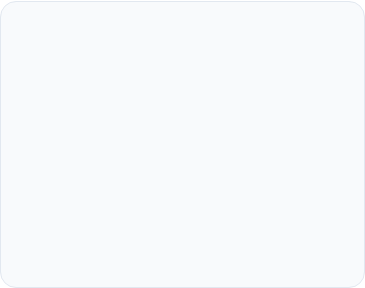



MULTI-DOMAIN CATALOG
Movies
Books
Games
Segmented dynamically into Action, Comedy, and Horror tiers.
Classified under educational and leisure paths: Science, History, and Fiction.
Mapped instantly for active users across Racing, Adventure, and Sports vectors.

Slide 4
SYSTEM ARCHITECTURE STRATEGY
Hierarchical Filtering: Implements nested logical structures to isolate main classes before drilling down to individual sub-genres.
Input Normalization: Utilizes explicit Python .lower() mutations on user strings to achieve robust validation against system rule-sets.
Exception Mitigation: Integrated catch-all conditional fallbacks to flag invalid inputs structural categories gracefully.

Slide 5
CONTENT MATRIX STRATEGY
Domain Class | Sub-Genre Vector | Top Pick Deployments
Movies | Action | Comedy | Horror | John Wick, Home Alone, The Conjuring
Books | Science | History | Fiction | Cosmos, Sapiens, Harry Potter
Games | Racing | Adventure | Sports | Forza Horizon, GTA V, EA FC 26

Slide 6

INTERACTIVE TERMINAL OUTPUT
DecodeLabs Recommendation Engine Console v3.0
Categories: 1. Movies 2. Books 3. Games
Deterministic Intent Resolution
Choose a category: movies
Movie Types: - Action - Comedy - Horror
The console output showcases nested lookup execution. Normalization correctly resolves case variations, verifying the structural accuracy of user recommendations instantly.
Choose movie type: action
Recommended Movies: 1. John Wick 2. Mission Impossible 3. Mad Max

Slide 7


THANK YOU
DecodeLabs Virtual Internship | Week 3 Completed
Presenter: Muhammad Salman

